Slide 1

HUMAN TRAFFICKING
Our Modern Slavery

Slide 2

BIBLICAL HISTORY
Lamentations 5:1, 11, 13, 15
O God, remember what has happened to us;
consider and see our degradation.
The women in Zion have been raped,
the young girls in the town of Judah.
Youths have been put to the mill,
boys stagger under loads of wood.
Joy has vanished from our hearts;
Our dancing has turned to mourning.

Slide 3
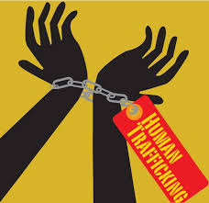
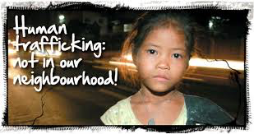
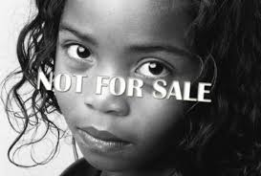
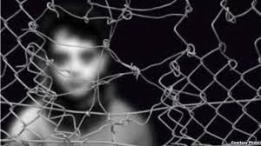

Slide 4
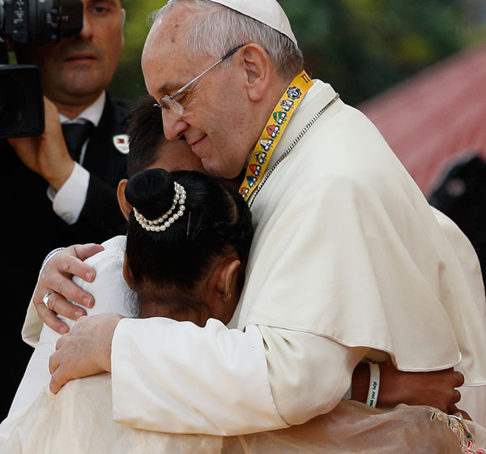
Pope Francis
I ask my brothers and sisters in faith and all men and women of good will for a decisive choice to combat trafficking in persons, which includes "slave labor".
May 1, 2013

Slide 5
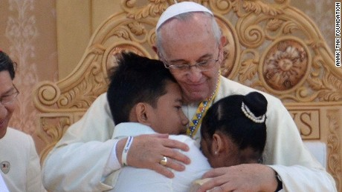
Pope Francis
“Every human being, man, woman, boy and girl, is made in God’s image.. Every person, and all people, are equal and must be accorded the same freedom and the same dignity.
Therefore, we declare on each and every one of our creeds is human trafficking. . . is a crime against humanity
our communities of faith are called to reject, without exception, any systematic deprivation of individual freedom for the purposes of personal or commercial exploitation; Declaration on International Day for the Abolition of Slavery, Dec. 2, 2014

Slide 6
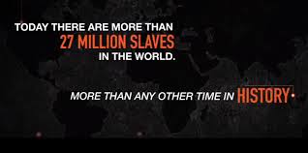
SLAVERY THEN AND NOW
Abraham Lincoln freed the slaves in 1864.
13.5 million slaves mainly from Africa.
Today estimated 27 million people in slavery from all parts of the world.
Internationally, 14.2 million are victims of labor trafficking.

Slide 7
Church Teaching
Catholic Social Teaching based on dignity of the human person, shared by all faith traditions.
The United States Conference of Catholic Bishops' (USCCB) Committee on Migration’s Statement "Human trafficking is a horrific crime against the basic dignity and rights of the human person. All efforts must be expended to end it.”

Slide 8
San Jose /Monterey Dioceses
Have initiated the Catholic Network to End Human Trafficking (CNEHT) in San Jose/Monterey Diocese South Bay Coalition to End Human Trafficking

Slide 9






Religious Congregations
Religious congregations, have taken corporate stances against human trafficking. Educate ourselves and others and take action.
NON VOX SED VOTUM,
NOT WORDS BUT DEEDS
SISTERS OF THE PRESENTATION

Slide 10
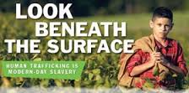
THE HUMAN FACE OF TRAFFICKING
A young woman in Los Angeles - three harrowing weeks as a sex slave in Las Vegas
Shirley - from Waco TX – forced into prostitution- San Jose
Sarah…forced into one room…the only connection to the outside world is a small window – serves 15 men each night
MIGUEL laborer

Slide 11
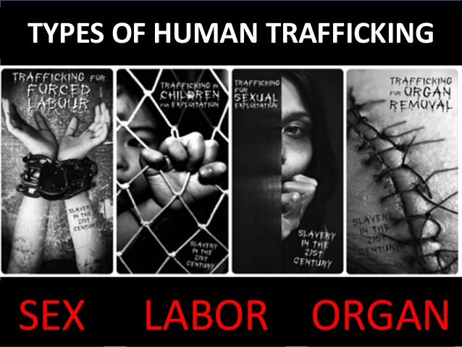
IN OUR OWN BACKYARD
13 yr old recruiting other 13 yr olds at a Sports Center
Deacon in Monterey learned from 11 yr. old that young people were being recruited in front of libraries and schools
A minor selling magazines and sex

Slide 12
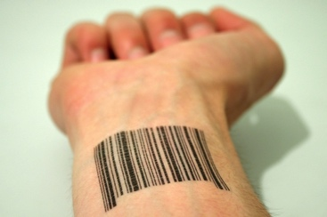
UN PROTOCOL Definition
The recruitment, transportation, transfer, harboring or receipt of persons, by means of threat or use of force or other forms of coercion, of abduction, of fraud, of deception, of the abuse of power.
Exploitation shall include, at a minimum, the exploitation of the prostitution of others or other forms of sexual exploitation, forced labor or services, slavery or practices similar to slavery, servitude or the removal or organs.
“Human trafficking is one of the most egregious violations of human rights facing the United Nations .” - Kofi Annan, former Sec’ty Gen’l

Slide 13
HOW BIG IS THE PROBLEM?
$150 billion a year
An average of 96,195 human persons are sold every day!
Estimated 21- 27 million trafficked worldwide—
for every 1 victim of sex trafficking there are 9 victims of labor trafficking
In US: 41% sex trafficking cases; 20% labor;
      22% combined 85% are women in sex trafficking cases
40% are men in labor trafficking cases
Notes:
Drug traffickers turning to human trafficking because it is more profitable and the penalties are less.

Slide 14
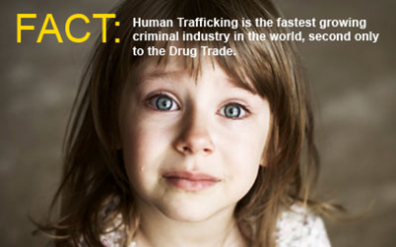
TRAGEDY OF CHILDREN
100,000 children are trafficked across the U.S. each year. The National Center for Mission and Exploited Children
Child prostitutes at truck stops as young as 11 years old.
A runaway child or teen can be contacted within 48 hours by a trafficker!

Slide 15
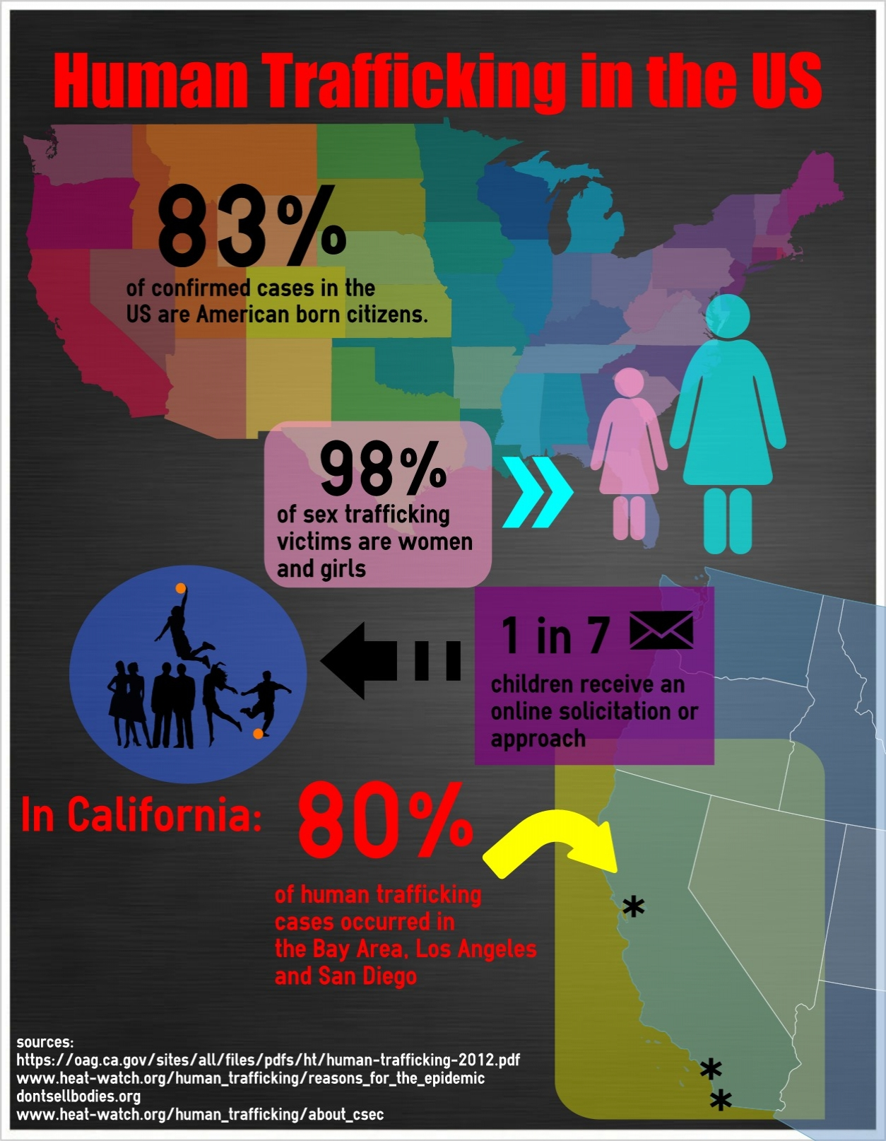

Slide 16
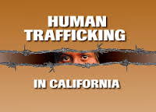
POLARIS and South Bay Coalition
Dec, 1, 2014 - CA highest number cases reported – (912); followed by Texas (452) Florida 364); New York (271)
Bay Area, Los Angeles and San Diego. 3 highest centers - FBI
South Bay Coalition - Total Served = 131
Countries of Origin for HT Victims Served: Mexico (43); USA (44); and others.

Slide 17
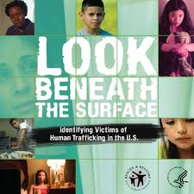
Who Are Victims of Trafficking?
Men, women and children
Varying ages and levels of education (Average age of 12-14 entering sex trade)
Voluntary migrants--Child refugees vulnerable
Children in foster care and juvenile probation are very vulnerable. 1 in 3 teen runaways are approached by a trafficker within 48 hrs.

Slide 18
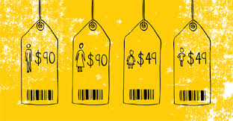
ROOT CAUSES
Lack of employment options
Increased economic disparity
Rapid and severe economic decline
Greed, migration situations (violence;
For youth: no stability in home; abusive situations; homelessness; foster care system
Lack of internet safety

Slide 19
People Are Trafficked For:
Criminal activity
Restaurant work
Construction
Hotel/motel housekeeping
Other informal labor sectors
Organ sales*
Domestic service
Sex work
Forced prostitution
Marriage
Factories
Begging
Agriculture (CA)
Notes:
Diplomatic immunity in D.C.; “mail order brides”;

Slide 20

How Are People Recruited?
Acquaintances or family
Newspaper advertisements, Backpage.com
Fake employment agencies
Front businesses
INTERNET
Word of mouth
Abduction
Use of threats, intimidation and violence
False promises
Notes:
Mail order brides,

Slide 21
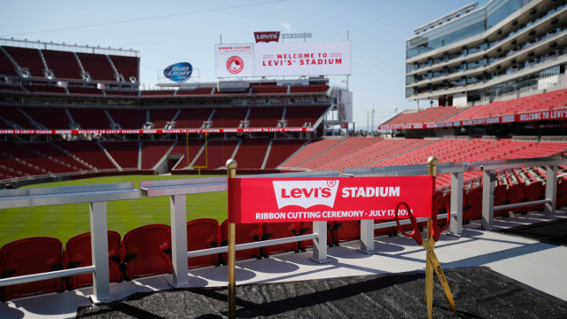
SPORTING EVENTS
Major sporting events -occasions for trafficking.
Women are moved into hotels adjacent to the event to “service” the patrons of the event.
ECPAT-USA Code for Hotels
Examples from sporting events. (Americas Cup in SF; Super Bowl 2015 – Arizona)
Upcoming Super Bowl 2016

Slide 22
Victims of Trafficking and VIOLENCE PROTECTION ACT 2000
  Provides trafficked persons immigration relief and other benefits
Prosecution
  Defines new crimes of trafficking and forced labor
Prevention
  U.S. State Dept. publishes annual Trafficking In Persons Report on countries’ efforts in combating trafficking
  Currently 13 bills before Congress re sex trafficking

Slide 23
Victims Of Human Trafficking Are Entitled to:
Compensation for
damages
Medical assistance
Social assistance
Seek Residence
Return
Safety
Privacy
Information
Legal representation
Be heard in court
Notes:
Rescue is not enough

Slide 24


WHAT CAN I/WE DO ? ACTIONS
PRAY everyday for victims/survivors/traffickers
LEARN AND SHARE
    Diocese of San Jose – www.dsj.org/endhumantrafficking
    Diocese of Monterey – www.dioceseofmonterey.orgstophumantrafficking
    Stop Trafficking jeansds@yahoo.com

Slide 25

OBSERVE
CITIZEN AWARENESS
Look for “clues”:
Evidence of being controlled
Inability to move or leave job
Bruises, signs of abuse
Fear or depression
Not speaking on own behalf
No forms of identification

Slide 26
IDENTIFY, REPORT
Polaris Project, national hotline. Put on cell phone.1-888-3737-888
TEXT BeFree (277-377)
San Jose Police Dept
Human Trafficking Task Force 408-537-1999

Slide 27
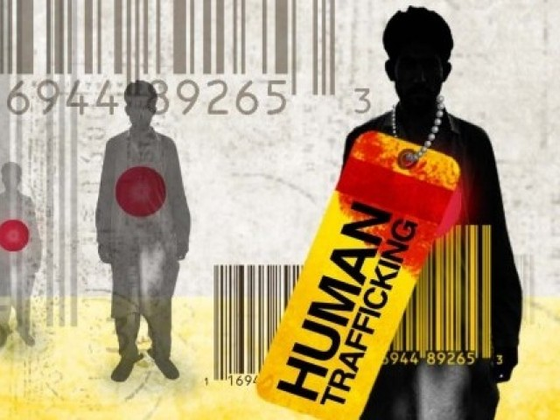
BECOME A RESPONSIBLE CONSUMER
FAIR TRADE: coffee,
chocolate
www.CRSFairtrade.org
Where are your clothes/uniforms made?
Go to “Made in a free world” www.slaveryfootprint/about#getapp

Slide 28
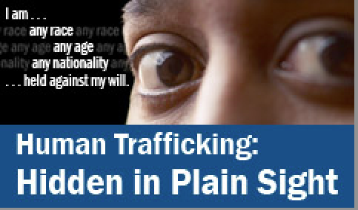
VOLUNTEER
CNEHT
SBCEHT
CATHOLIC CHARITIES DSJ

Slide 29
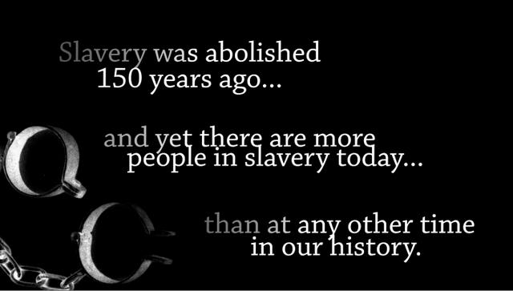
ADVOCACY
URGE STATE legislators
  to strengthen laws against trafficking
  to provide resources for law enforcement to be trained in recognizing trafficking
  to treat trafficked persons as victims, not criminals.
Support US HOUSE and SENATE BILLS

Slide 30
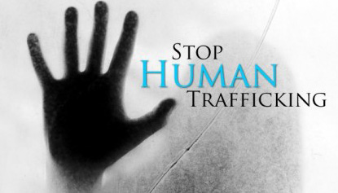
SUPPORT FINANCIALLY
SBCEHT
Community Solutions
Super Bowl – 2016 group
No Traffic Ahead
website project
Social Agencies
Freedom House (Monarch, Nest)
CATHOLIC CHARITIES

Slide 31
Social Service Agencies Provide:
Assessment of needs for social services and making a service plan
Helping trafficked persons obtain:
  Food and housing
  Medical care
  Mental health services
  Education and employment
  Life skills
  Government benefits
Crisis intervention counseling and supportive counseling

Slide 32
STOP THE DEMAND
If trafficked persons are the supply, the desire for cheap commercial sex and labor is the demand.
Implications for how we raise our young men.
Male machismo in our culture.
Link between pornography and sexual violence

Slide 33
Government Partners in Combating Human Trafficking
U.S. Department of State
  Interagency Task Force
  Office to Combat and Monitor Trafficking in Persons
U.S. Agency for International Development
U.S. Department of Justice
  Civil Rights Division, Criminal Section
U.S. Department of Health and Human Services
  Office of Refugee Resettlement
U.S. Department of Labor
U.S. Department of Homeland Security

Slide 34
TEENS USE OF SOCIAL MEDIA FROM PEW RESEARCH POLL – APRIL, 2015
73% of Teens have or have access to a smartphone
91% of teens go online using a mobile device
24% of teens say they go online “almost constantly”
71% of teens ages 13 to 17 years use Facebook
52% of teens use Instagram
41% of teens use Snapchat
33% of teens use Twitter

Slide 35
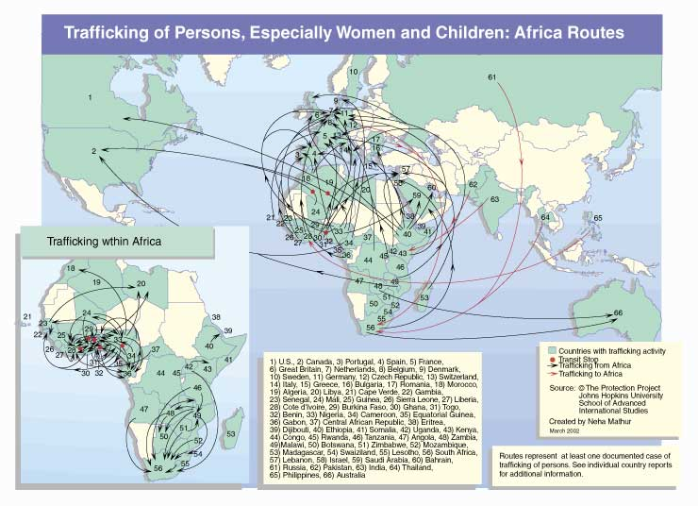

Slide 36
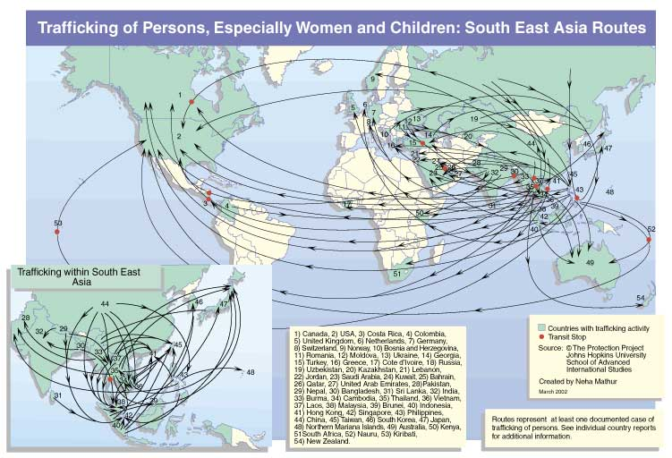

Slide 37
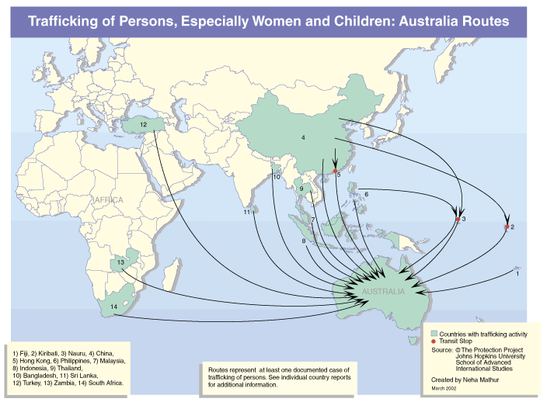

Slide 38
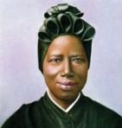
PRAYER – St. Josephine Bakhita
St,.Josephine Bakhita,
you were sold into slavery as a child
and endured untold hardship and suffering.
Once liberated from you physical enslavement,
you found true redemption in your
encounter with Christ and his Church.
O St. Bakhita, assist all those who are trapped
in a state of slavery.
Intercede with God on their behalf
so that they will be released form their chains of captivity.
Those whom humans enslave, let God set free.
Provide comfort to survivors of slavery
and let them look to you as an example of hope and faith.
Help all survivors find healing from their wounds
We ask for your prayers and intercessions for
those enslaved among us. Amen.
USCCB

Slide 39

Information Compiled By
Sister Rosemary
Everett, SNJM
Sister Marilyn Wilson, BVM
Sister Elizabeth Avalos, BVM

